Slide 1
SHA-1
The SHA1 encryption algorithm (SHA1), can be used to generate a condensed representation of a message called a message digest.
The SHA1 is required for use with the Digital Signature Algorithm (DSA) .
Both the transmitter and intended receiver of a message in computing and verifying a digital signature uses the SHA1.

Slide 2
SHA1 is used for computing a condensed representation of a message or a data file.
When a message of any length < 2 64 bits is input, the SHA1 produces a 160-bit output called a message digest. T
The message digest can then be input to the Digital Signature Algorithm (DSA), which generates or verifies the signature for the message.

Slide 3
Signing the message digest rather than the message improves the efficiency of the process because the message digest is usually much smaller in size than the message.
The same hash algorithm must be used by the verifier of a digital signature as was used by the creator of the digital signature.

Slide 4
The SHA1 is secure because it is computationally infeasible to find a message which corresponds to a given message digest, or to find two different messages which produce the same message digest.
Any change to a message in transit will, with very high probability, result in a different message digest, and the signature will fail to verify.

Slide 5
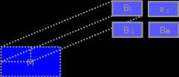
First the message is padded and the length of the message is added to the end.
It is then split into blocks of 512 bits .

Slide 6
The blocks are then processed one at a time. Each block must be expanded and compressed.
The value after each compression is added to a 160bit buffer called the current hash state.
After the last block is processed the current hash state is returned as the final hash.

Slide 7
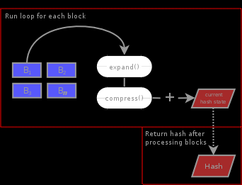

Slide 8
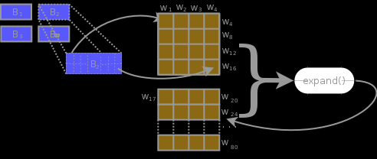
For expansion each 512 bit message block is separated into chunks of 32 bits.
These 16 chunks are then used to create 64 more chunks for a total of 80.

Slide 9
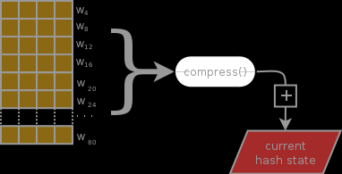
All 80 of these chunks are compressed into a 160 bit value which is added to the current hash state .

Slide 10
The expansion and compression functions are repeated for each block with the return constantly being added to thec urrent hash state buffer.
Once all blocks have been processed ,this value that is returned as the hash of the message.

Slide 11
Message Preparation The message is prepared in 4 steps:
Append a single binary 1 bit to the message
Split into blocks of 512 bits each .
The last block must be equal to 448 so that we can append the message length .
If it is under pad with binary 0 bits until equal to 448. If over, pad until it is 512 bits and create an additional block of 448 binary 0 bits.
Append the length of the original message to the last block. Represent this length as a 64 bit integer (making the last block equal to 512 bits).

Slide 12
Before process any blocks , must initiate the hash state buffer.
The buffer is actually 5 separate 32 bit integers:
h0 = 67452301
h1 = EFCDAB89
h2 = 98BADCFE
h3 = 10325476
h4 = C3D2E1F0

Slide 13
Block expansion Each 512 bit block is split further into 32 bit chunks (“words“) .
These 16 chunks are then expanded to a total of 80.
The processes of expansion is a simple XOR of 4 values.
For instance, the next chunk, chunk 17, is created by XOR’ing together chunk 17-3, 17-8, 17-14 and 17-16.

Slide 14
For chunk 18 run the same processes but subtracting from 18 instead of 17.
Continues until all 80 have been created.

